Slide 1
CUSTOMER SEGMENTATION
Submitted in the partial fulfillment for the award of the degree of
BACHELOR OF ENGINEERING
IN
CSE IBM BIG-DATA 1B
Submitted by:
Kuber Khandelwal
19BCS3815
Under the Supervision of:
SEEMA BADRA
Department of AIT-CSE
DISCOVER . LEARN . EMPOWER

Slide 2
TEAM MATES
Moksha Aggarwal 19bcs3797
Gurleen Kaur 19bcs3795
Isha Arora 19bcs3789
Kuber Khandelwal 19bcs3815
Suraj 19BCS3793

Slide 3
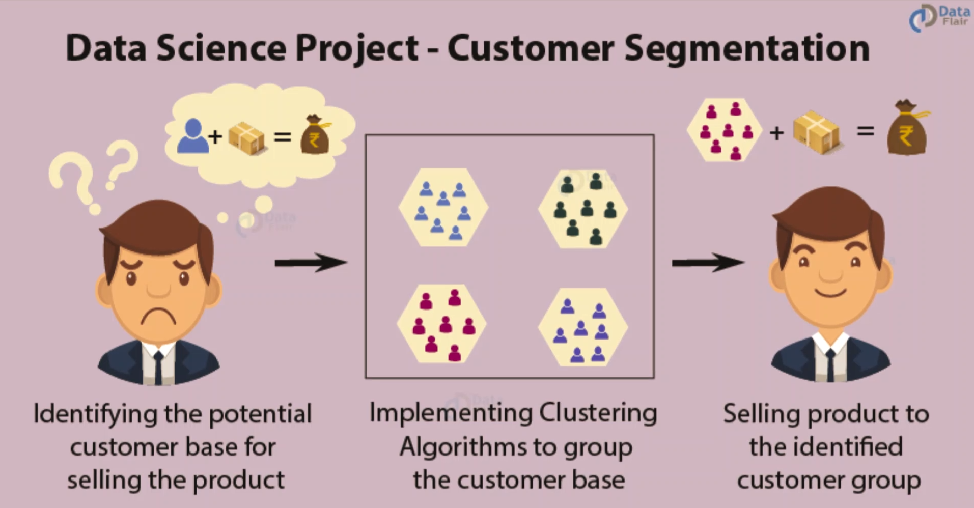

Slide 4
Outline
Introduction to Project
Problem Formulation
Objectives of the work
Methodology used
Results and Outputs
Conclusion
Future Scope
References

Slide 5
Introduction to Project:
Process of classifying a customer base into several groups of people who share similarities in a variety of ways such as gender, age, interests and spending habits.
Companies using this are under the impression that all customers have different needs and need specific marketing effort to address them appropriately.

Slide 6
With the data collected, companies can gain a deeper understanding of customer preferences and the need to acquire key components that can earn them a high profit.
It is one of the most important applications for unsupervised learning.
Using clustering techniques, companies can target a number of customer segments that allow them to identify a potential user base.

Slide 7
Project Formulation:
1. K-means Clustering
The k-means rule works by taking k centroids and indiscriminately putting them across the dataset, ideally so they're equally spaced out.
Every data point then gets assigned to the center of mass it's highest to, that is that the center of mass with the littlest Euclidian Distance between it and also the data point.
Once all the info are assigned , the centroids update by turning into the mean of all the info assigned to that. once the centroids stop moving or the assignments stop dynamic , the rule stops.
To urge on the brink of the best answer for a selected k, it's counseled to rerun the rule with completely different initial center of mass assignments.

Slide 8
2. Preparing Data
It is necessary to :
consider the raw data
examine its format and original features
transform them into a workable format for the task at hand.
In short, transaction-based variables need to be converted into customer-based variables.

Slide 9
2.1 Feature Engineering
The process of creating or extracting features from raw data is commonly referred to as feature engineering.
The first and most important step of data preprocessing
Establishes the features that the model will consider when clustering
Involves inspecting and manipulating the raw data to somehow extract features that are worth- while for analysis

Slide 10
2.2 Criteria of Clustering
To expedite the clustering process, the new customer data needed to undergo minor data preprocessing.
Certain customers were pruned from the dataset if they did not meet certain self-imposed constraints.

Slide 11
2.3 Performing Analysis and Result
Data Exploration and Visualization
import the essential packages required for this role
read the data
go through the input data to gain necessary insights about it.

Slide 12
Objectives:
Features a vital impact on client management.
Dividing customers into completely different helps to promote to each phase distinctively and effectively.
Helps to specialize the wants of every reasonably client .
Allow a corporation to emerge as an energetic, assertive, and even aggressive business..
The idea here is that after a corporation is well-versed with its customers’ profiles, it’s a lot of possible to justifiably ascertain what they have.

Slide 13
Methodology used
Data exploration
Descriptive analysis of data i.e data visualization
Implementation of several versions of k means algorithm
Using K-means clustering.

Slide 14

Results and Outputs:
This project is made
By using R studio and R language

Slide 15
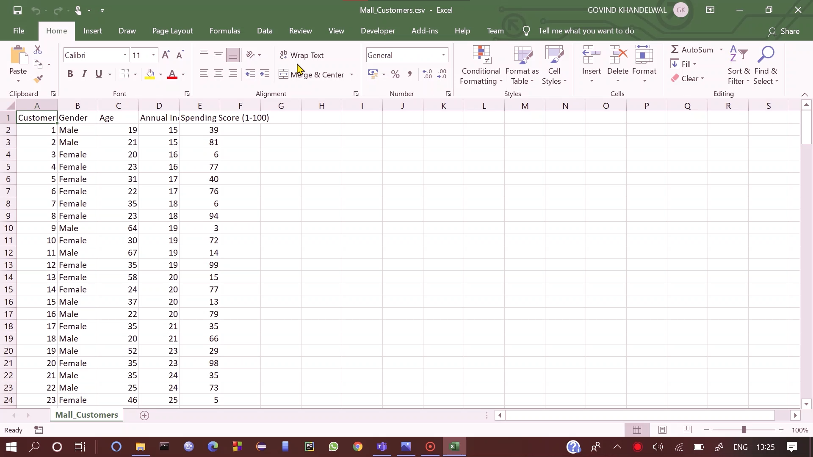
The data is stored in excel sheet format of customers with their gender, age their annual income and spending score.

Slide 16
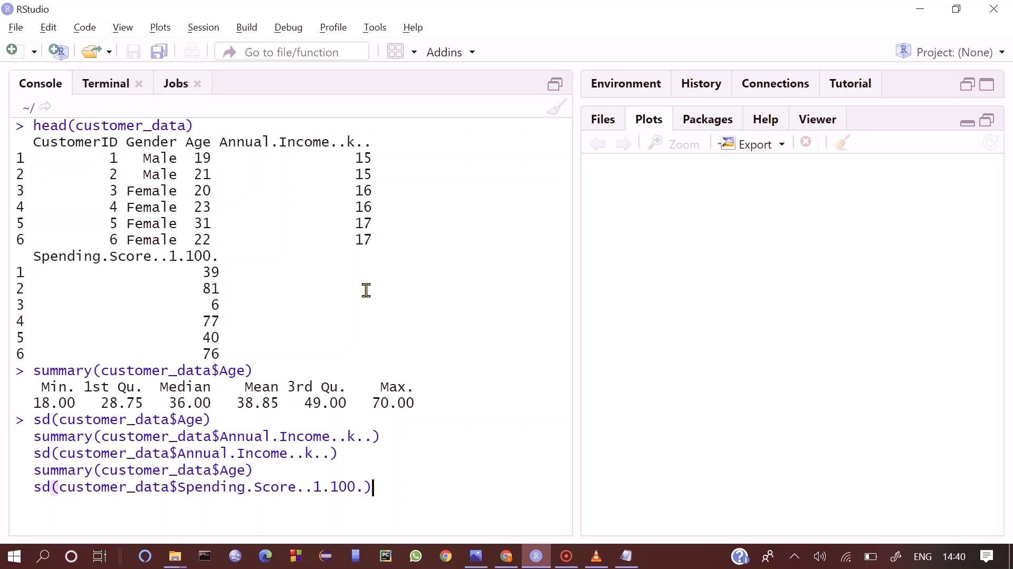
CUSTOMERS DATA EXPLORATION

Slide 17
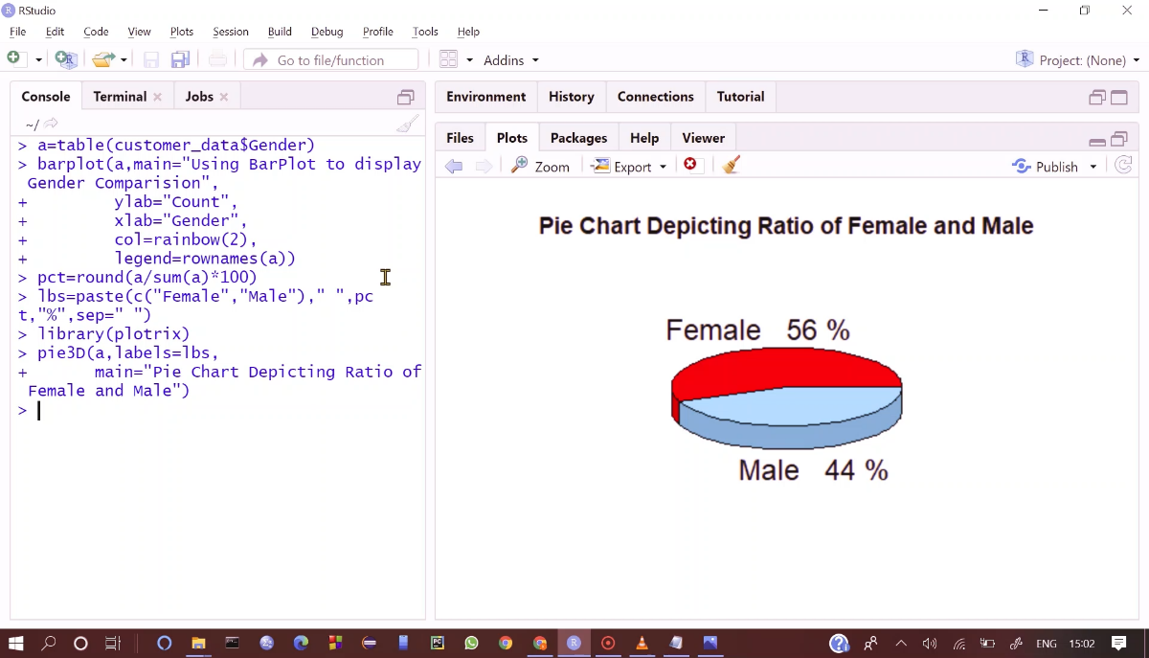
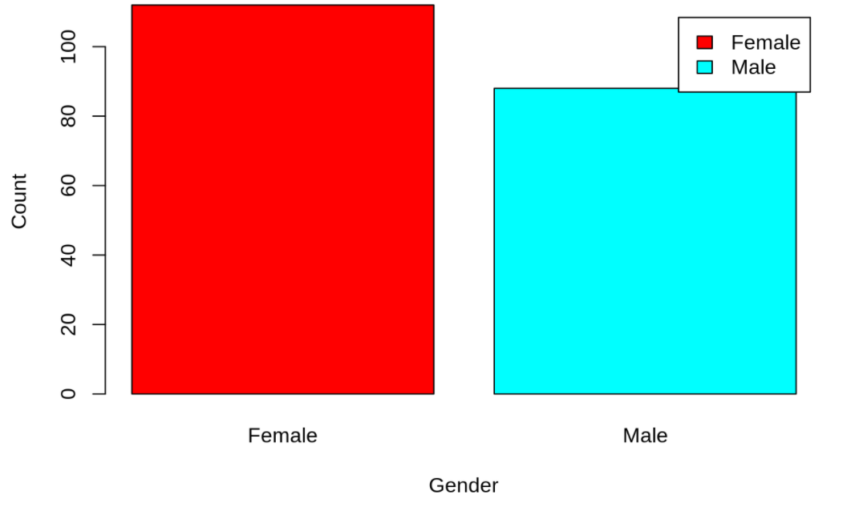
CUSTOMER GENDER VISUALIZATION SHOWN IN FORM OF PIE CHART and also bar plots.

Slide 18
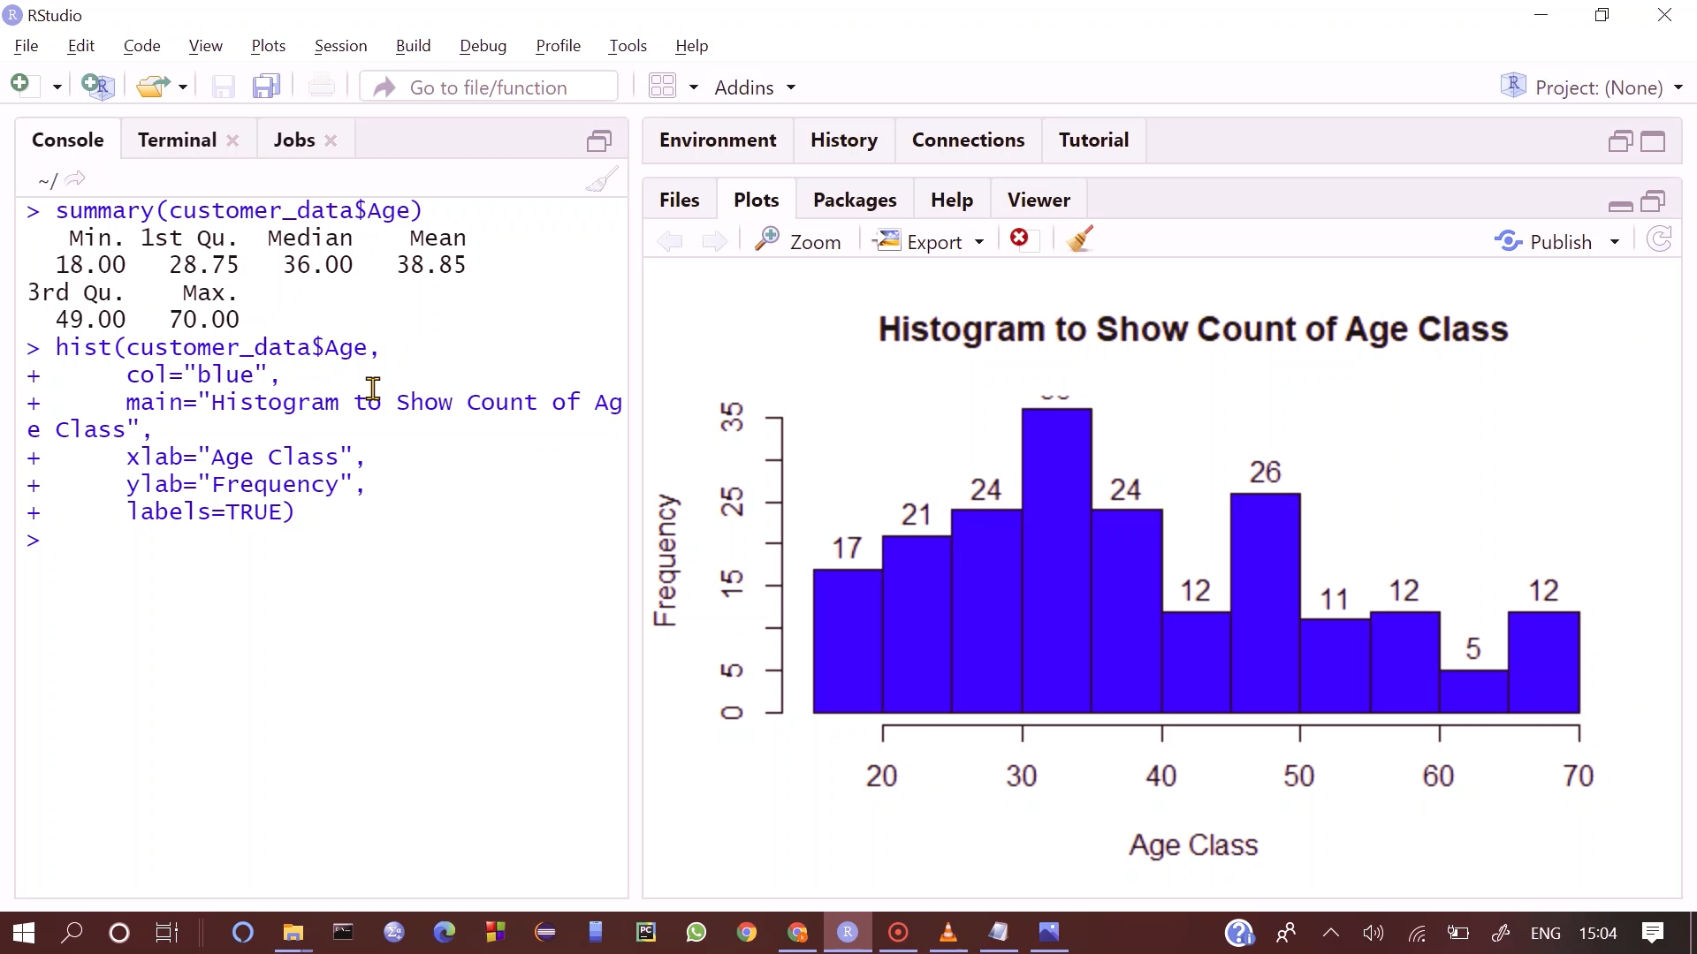
CUSTOMERS AGE VISUALIZATION SHOWN IN FORM OF HISTOGRAM

Slide 19
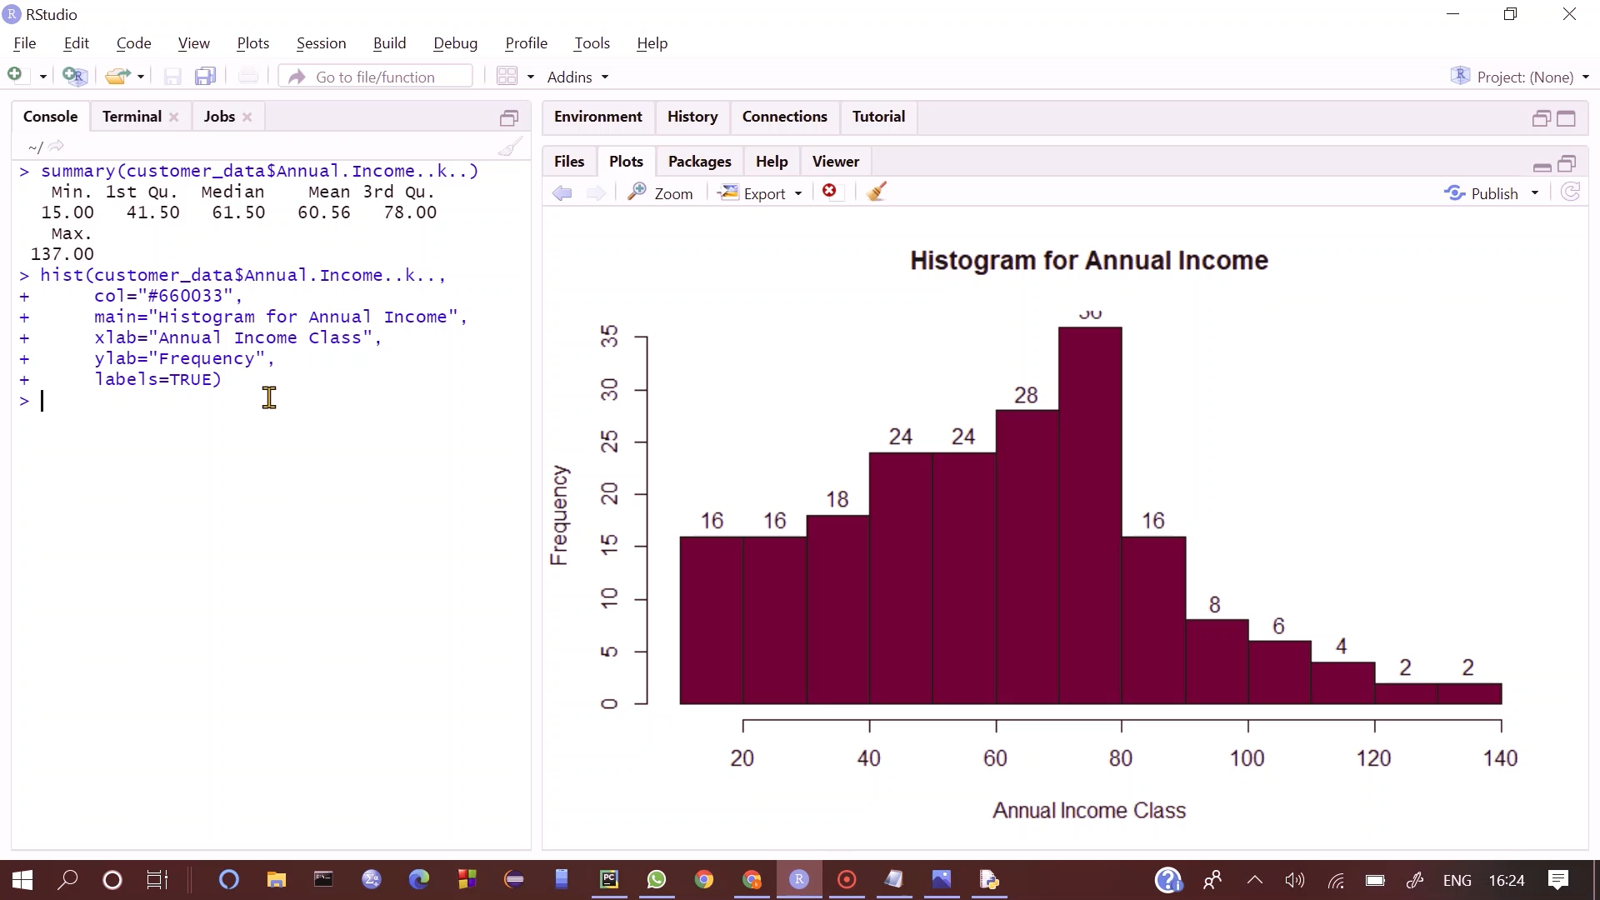
ANALYSIS OF THE ANNUAL INCOME OF THE CUSTOMERS SHOWN IN THE FORM OF HISTOGRAM

Slide 20
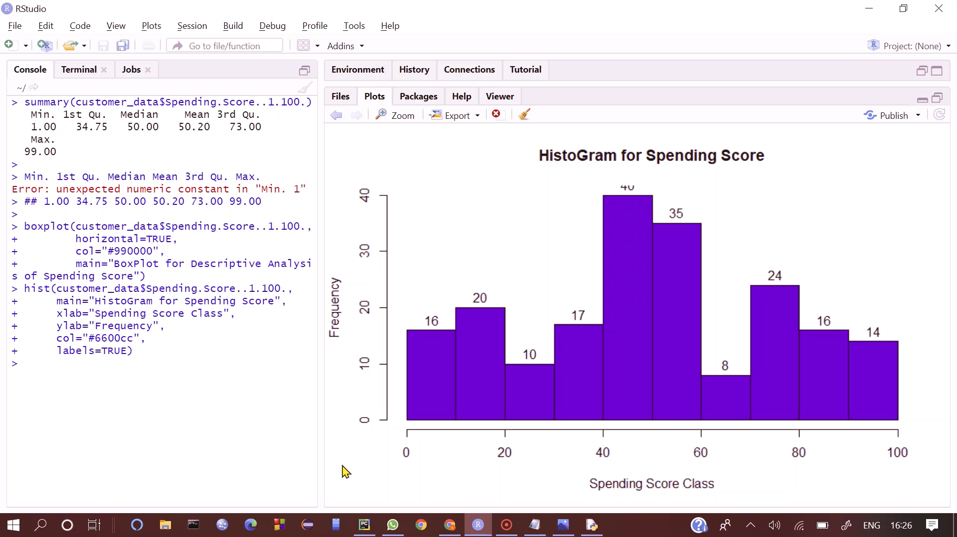
ANALYSING SPENDING SCORE OF THE CUSTOMERS IN THE FORM OF HISTOGRAM

Slide 21
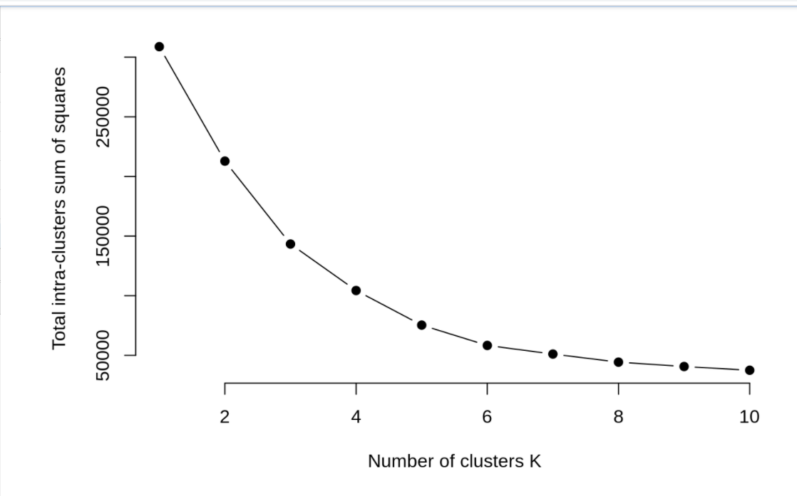
From the above graph, we conclude that 4 is the appropriate number of clusters since it seems to be appearing at the bend in the elbow plot.

Slide 22
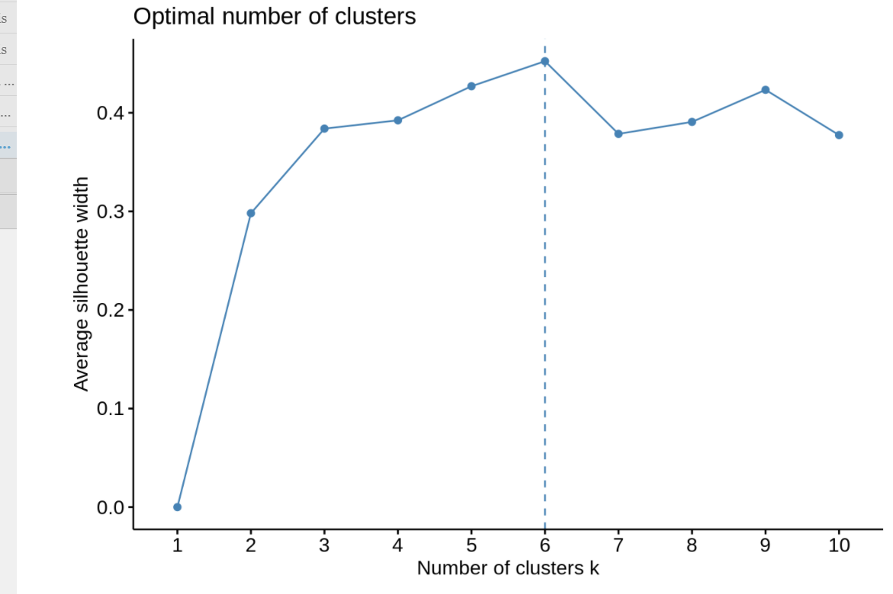
According to silhouette method

Slide 23
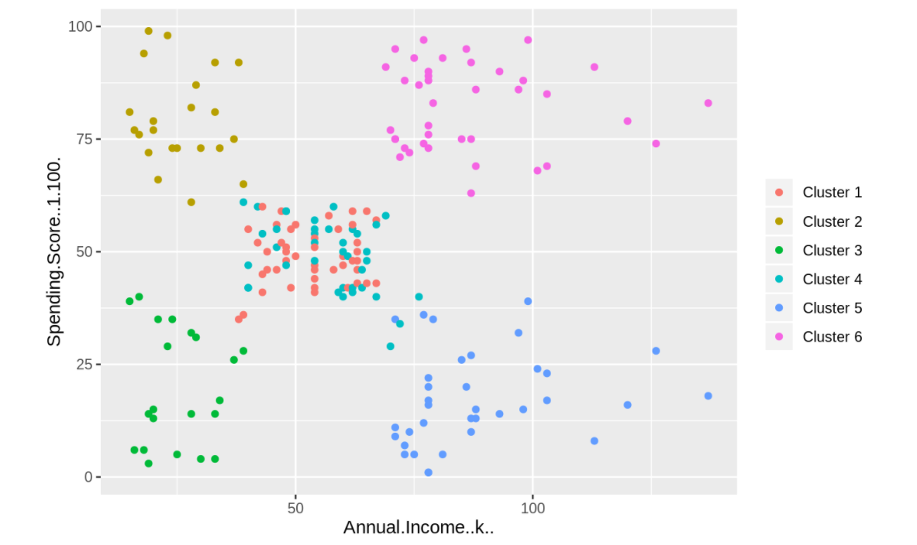
Segments of customers using k means algorithm

Slide 24
Conclusion:
Customer segmentation is the foundation for meeting individual customers needs at the right time, on the right platform, and with the right message. This necessitates customer data, which should preferably be centrally consolidated, up-to-date, and instantly activatable, allowing for timely responses to customer needs and actions.
Every business should strive to use segment-of-one marketing in conjunction with other segmentation techniques. Companies must keep up with the consumer offerings provided by broad networks if they are to retain and improve their direct customer access in the face of rising customer needs and expectations.

Slide 25
Future Scope:
The impact it can have on every part of the organization — sales, marketing, product development, customer service, etc. — is immense. The business will possess stronger customer focus and market clarity, allowing it to scale in a far more predictable and efficient manner.
Ultimately, that means no longer needing to take on every customer that is willing to pay for your product or service, which will allow you to instead hone in on a specific subset of customers that present the most profitable opportunities and efficient use of resources. That is critical for every business, of course, but at the expansion stage, it can often be the difference between incredible success and certain failure.

Slide 26
References:
Bhatnagar, Amit; Ghose, S. (2004), ‘A latent class segmentation analysis of e-shoppers’, Journal of Business Research 57, 758–767.
Chen, D., Sain, S. L. & Guo, K. (2012), ‘Data mining for the online retail in- dustry: A case study of rfm model-based customer segmentation using data mining’, Journal of Database Marketing & Customer Strategy Management 19(3), 197–208.
URL: https://doi.org/10.1057/dbm.2012.17
Cooil, B., Aksoy, L. & Keiningham, T. L. (2008), ‘Approaches to customer segmentation’, Journal of Relationship Marketing 6(3-4), 9–39.
Marcus, C. (1998), ‘A practical yet meaningful approach to customer segmen- tation approach to customer segmentation’, Journal of Consumer Marketing 15, 494–504.
Mattson, M. P. (2014), ‘Superior pattern processing is the essence of the evolved human brain’, Frontiers in Neuroscience 8, 265.
Morrison, C., Gruenewald, P. J., Freisthler, B., Ponicki, W. R. & Remer,L. G. (2014), ‘The economic geography of medical cannabis dispensaries in california’, International Journal of Drug Policy 25(3), 508 – 515.
URL: http://www.sciencedirect.com/science/article/pii/S0955395913002387
Rajaraman, A. & Ullman, J. D. (2011), Mining of Massive Datasets, Cam- bridge University Press, New York, NY, USA.
Rogers, S. & Girolami, M. (2016), A First Course in Machine Learning, Second Edition, Chapman & Hall/CRC.
Roux, M. (2018), ‘A comparative study of divisive and agglomerative hierar- chical clustering algorithms’, Journal of Classification 35(2), 345–366.
URL: https://doi.org/10.1007/s00357-018-9259-9

